Slide 1
UGV
An Introduction

Slide 2
Motion

Slide 3
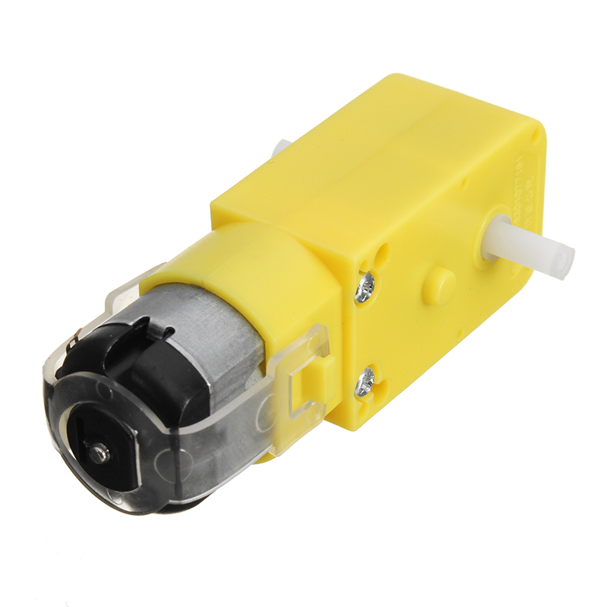
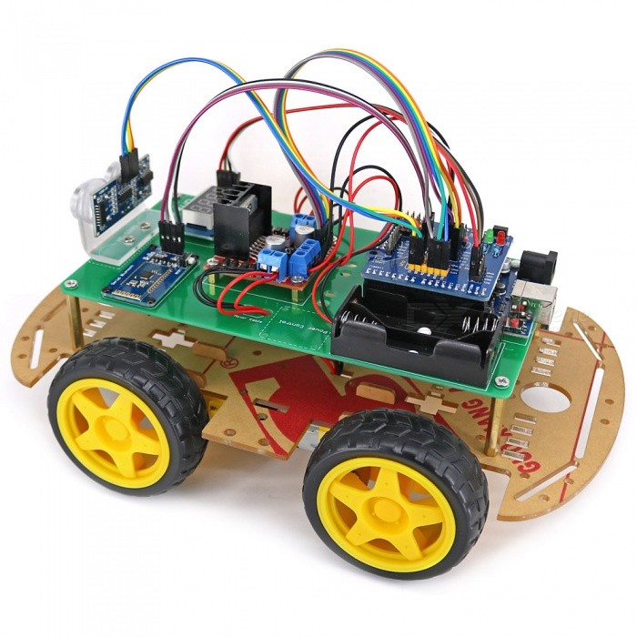
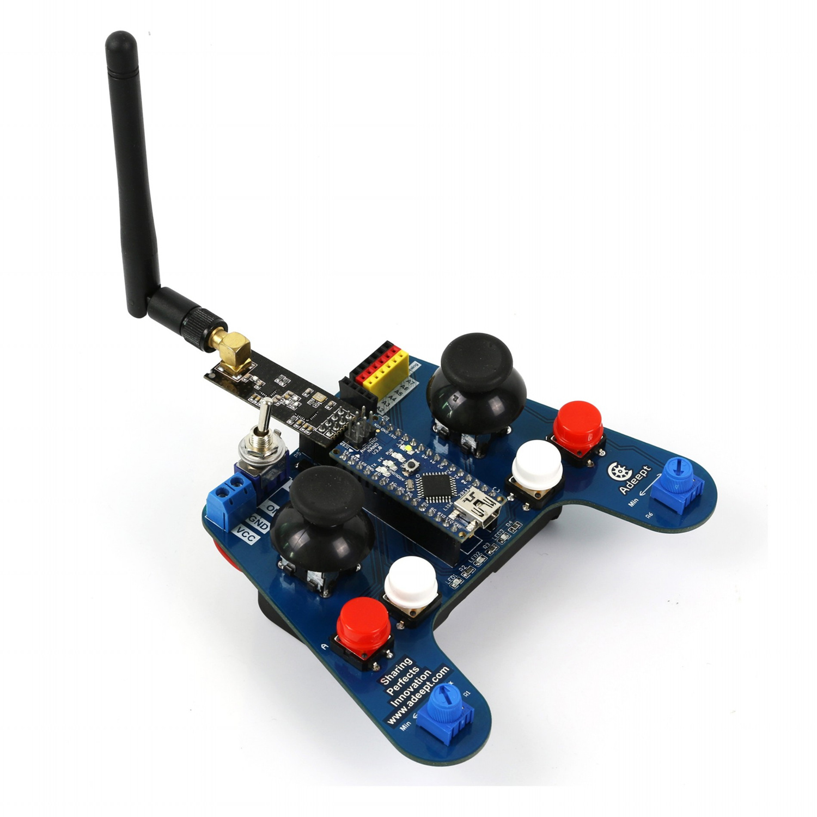
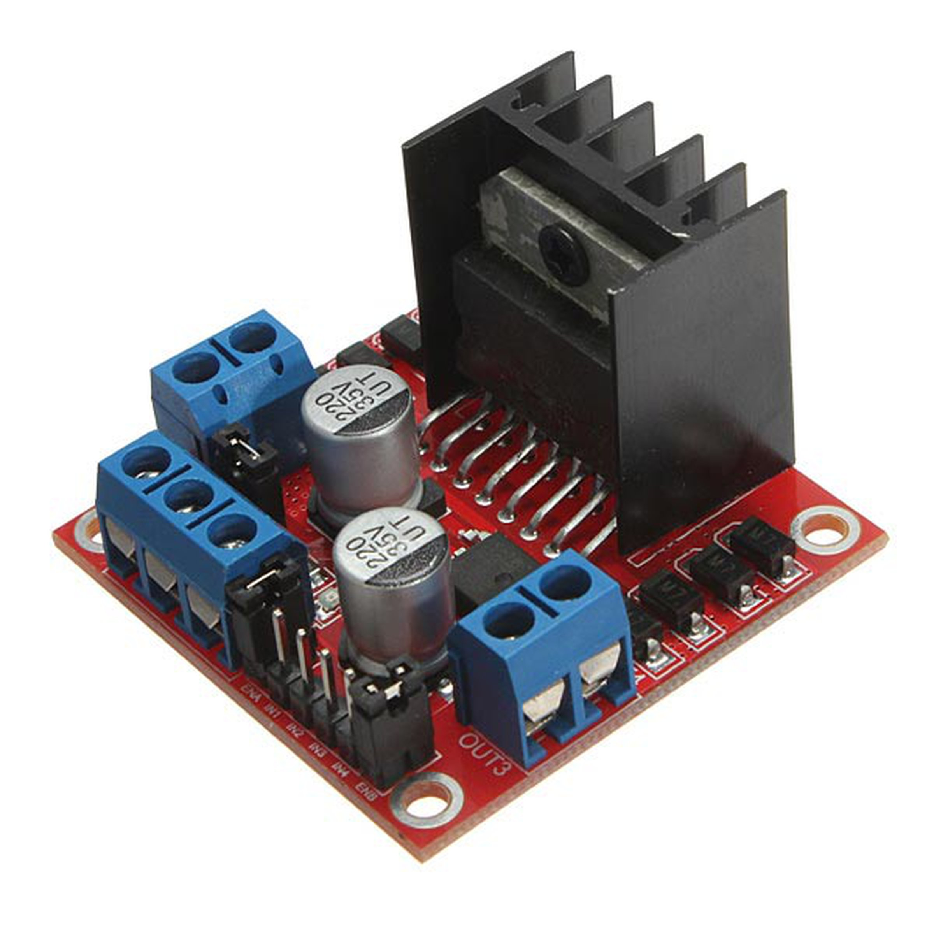
Motion
Motors
Motor driver
Speed
Control

Slide 4
Motors

Slide 5
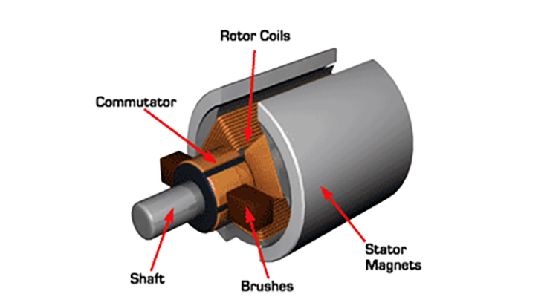
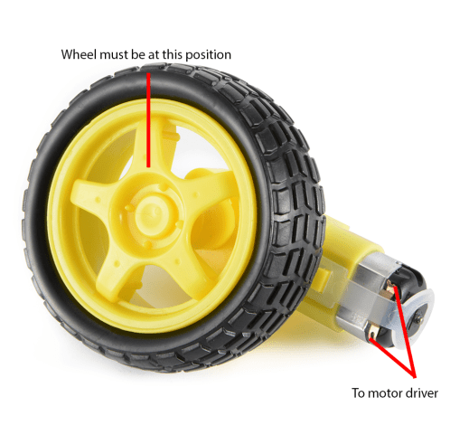
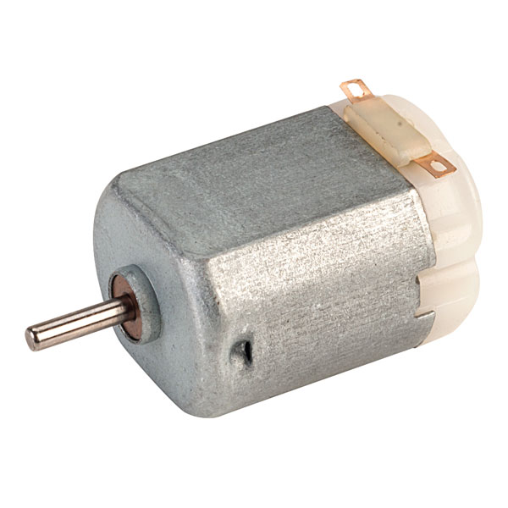
DC Motor

Slide 6
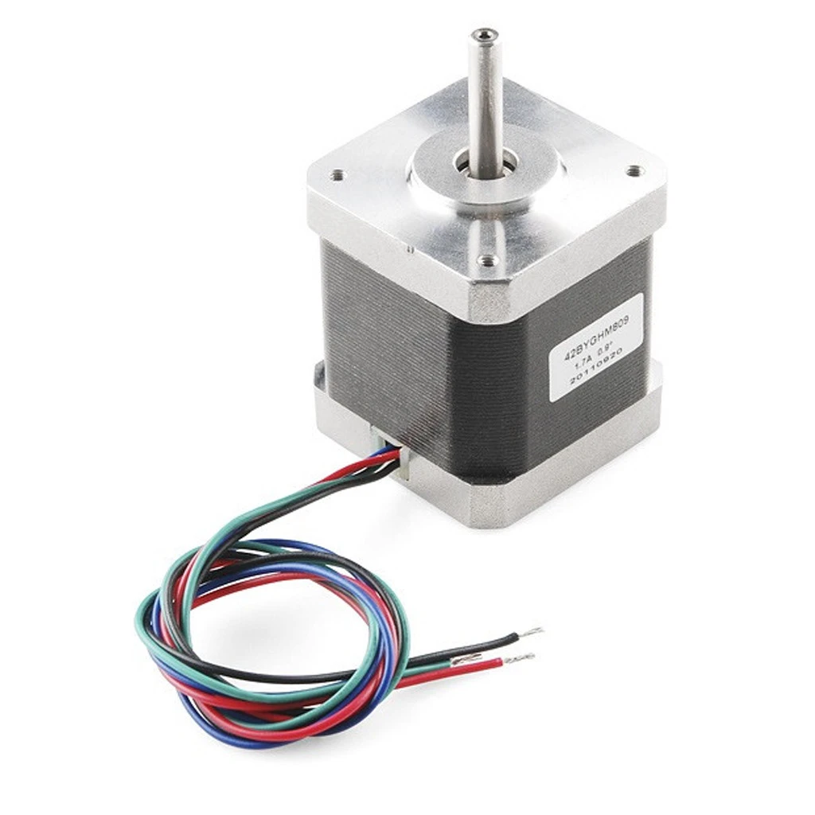
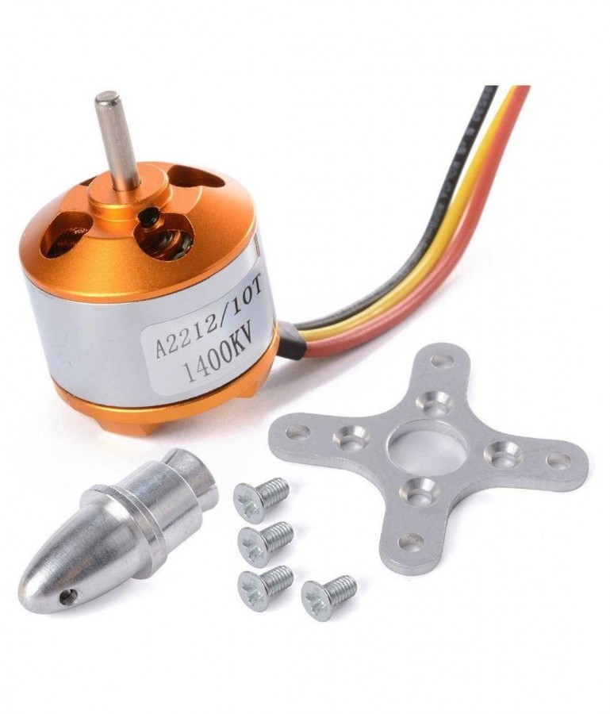
Other motors
Brushless DC Motor
Stepper Motor

Slide 7
Motor Driver

Slide 8
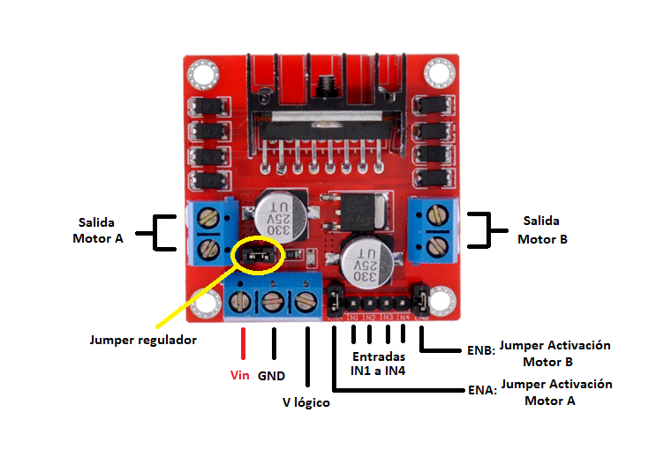
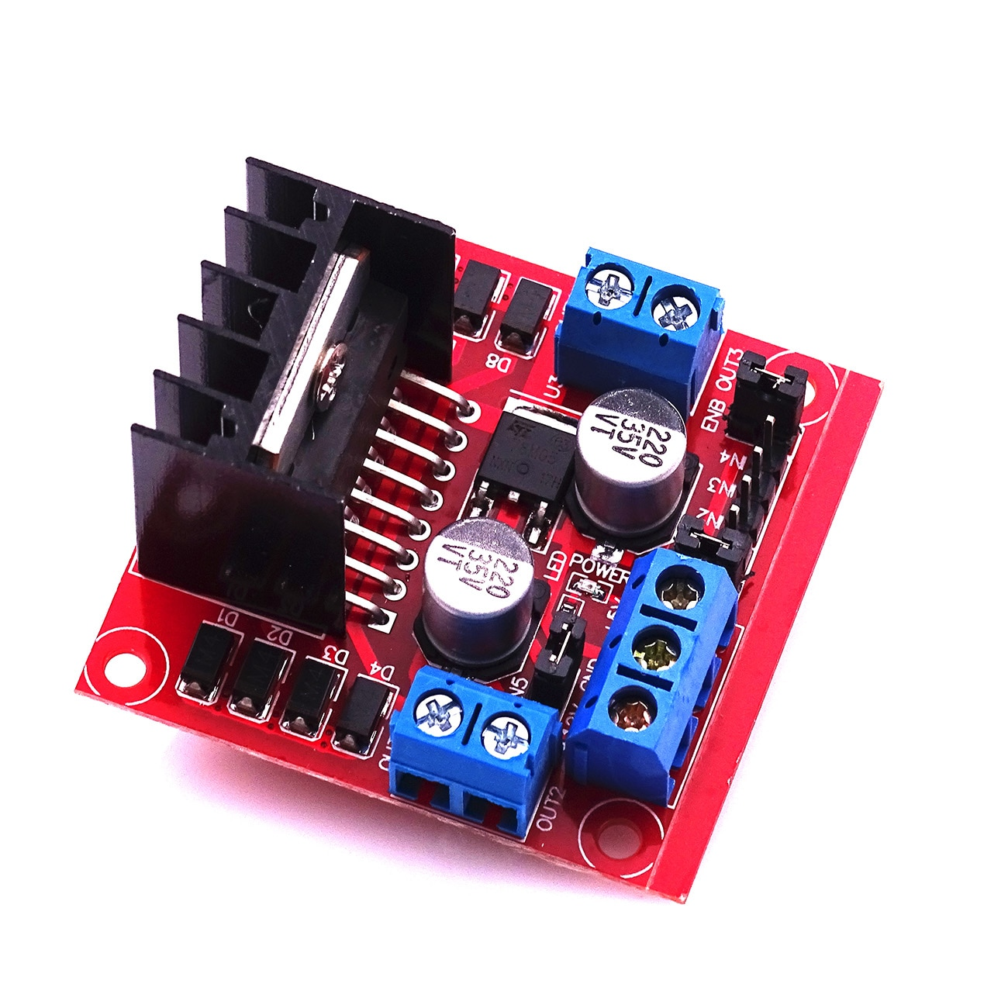
Motor driver

Slide 9
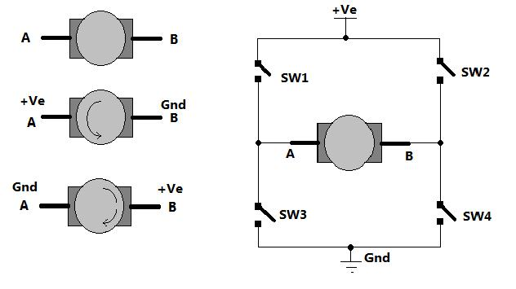
H-Bridge

Slide 10
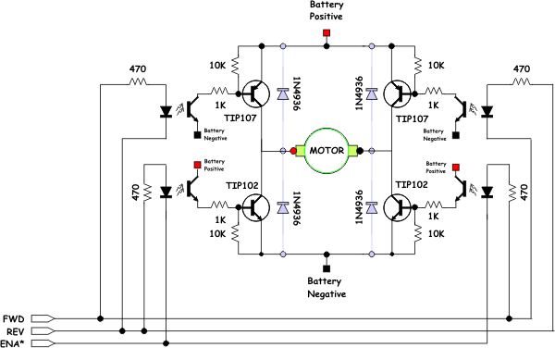
H-Bridge

Slide 11
Control

Slide 12

Bluetooth

Slide 13
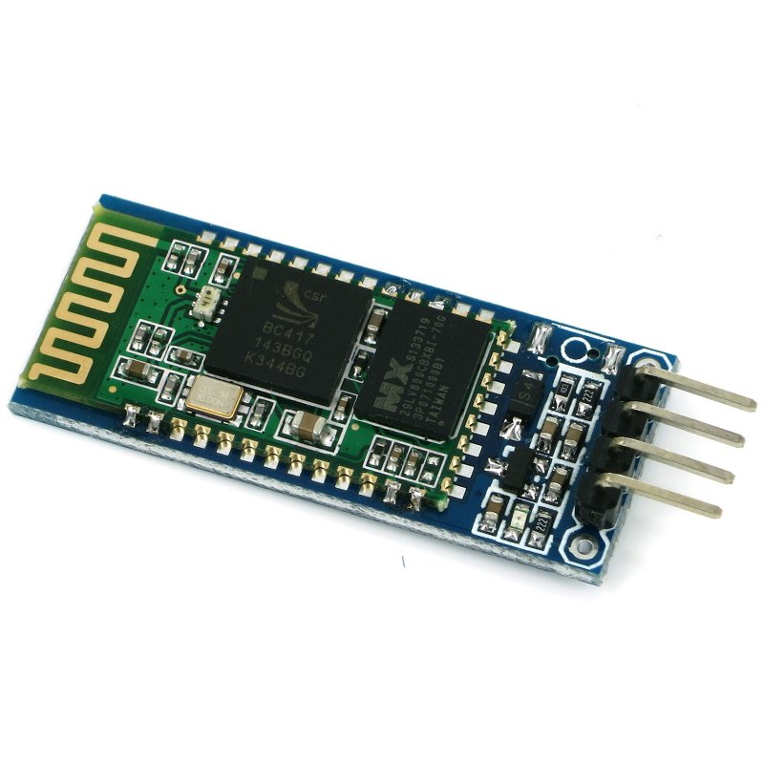
Bluetooth

Slide 14
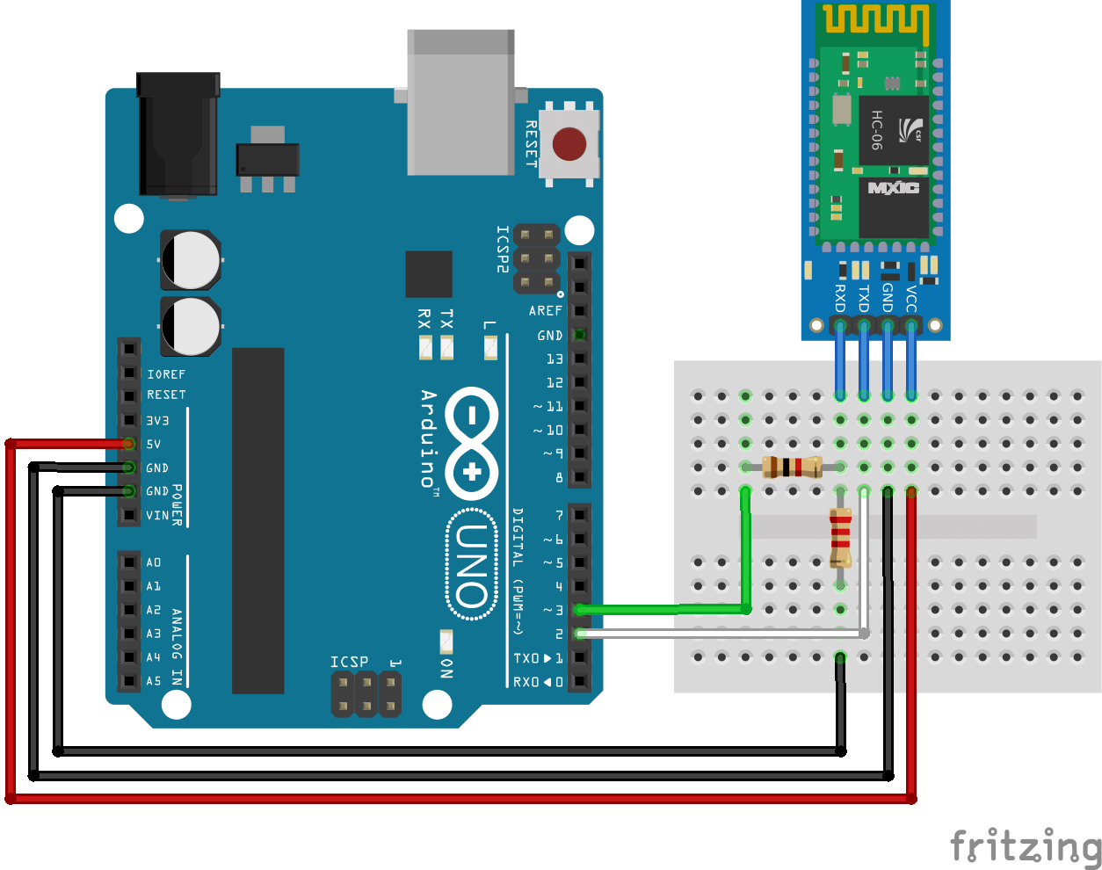
Connect to Arduino

Slide 15
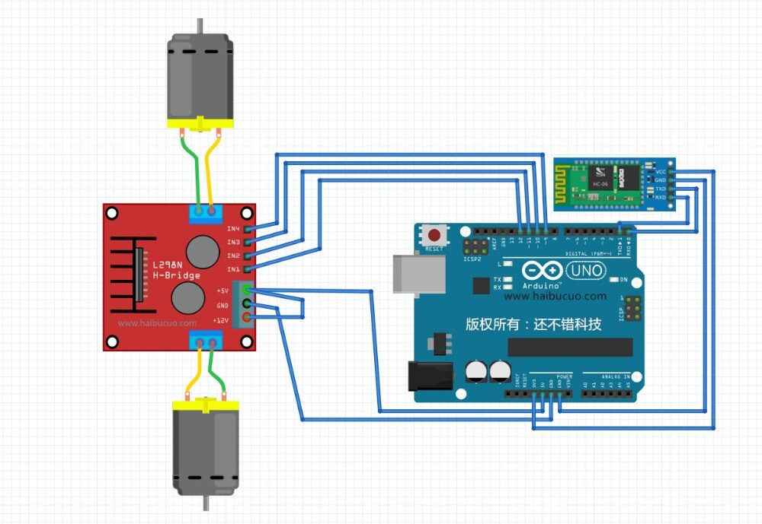

Slide 16
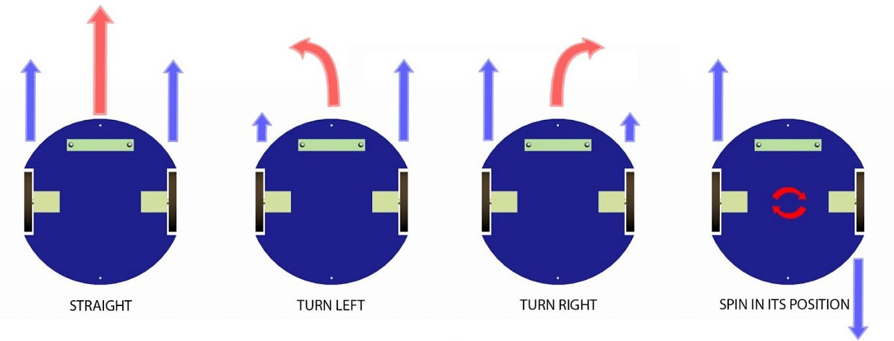
Steering

Slide 17
Speed

Slide 18
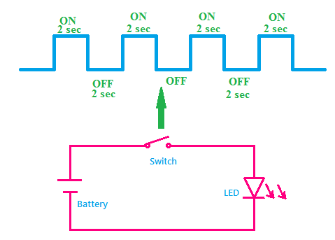
Pulse Width Modulation

Slide 19
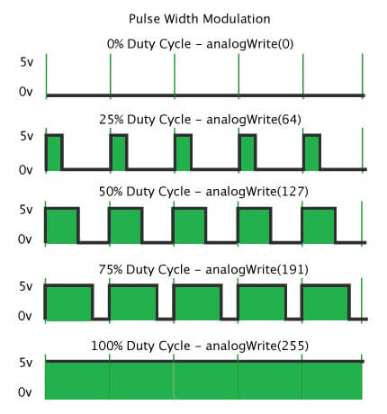
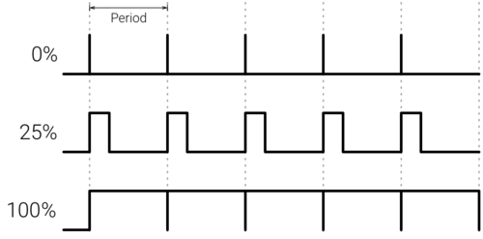
Pulse Width Modulation

Slide 20
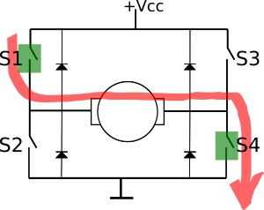
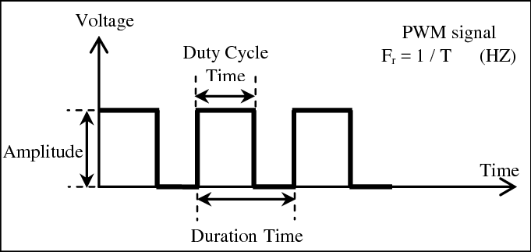
H-Bridge with PWM

Slide 21
Sensors

Slide 22
Ultrasonic

Slide 23
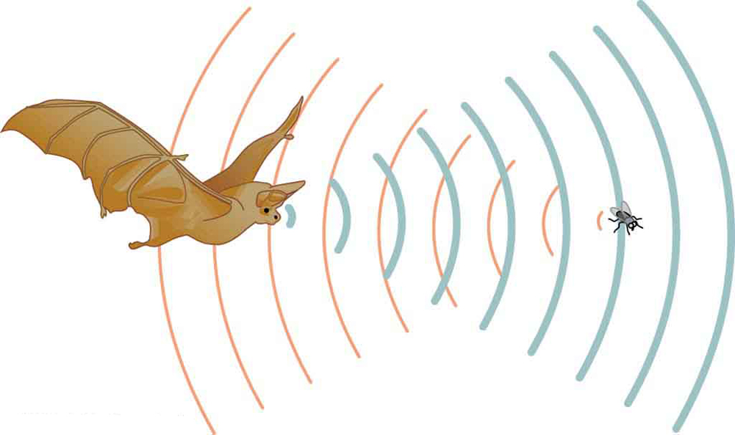
Sound Waves

Slide 24
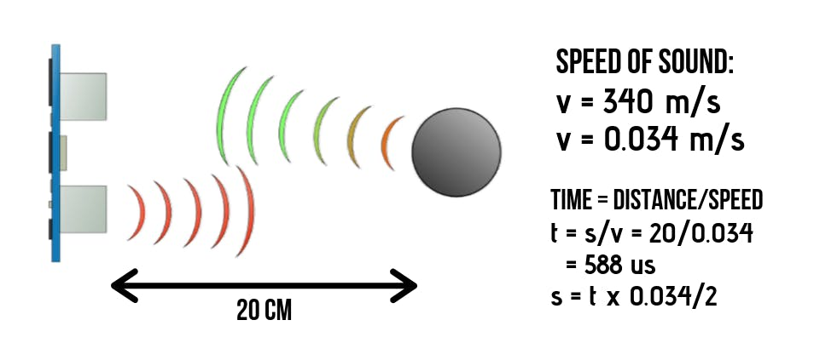
Ultrasonic
The Sound Speed
speed of the sound is 340 m/s or 0.034 cm/µs

Slide 25
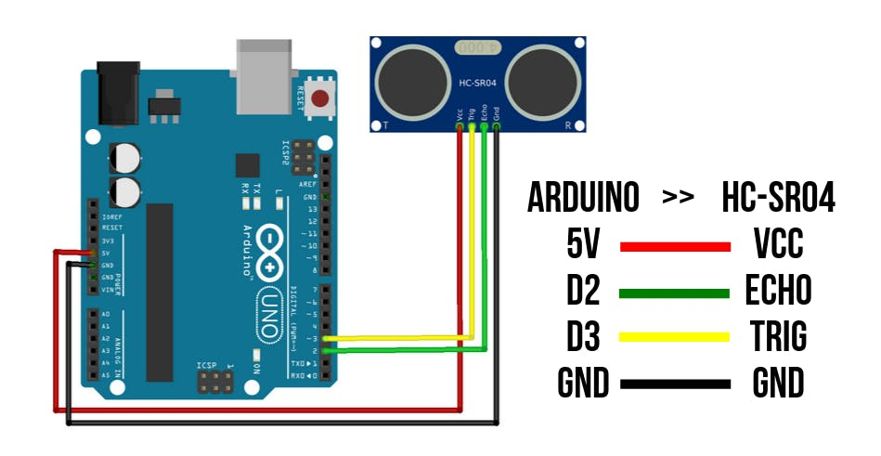

Slide 26
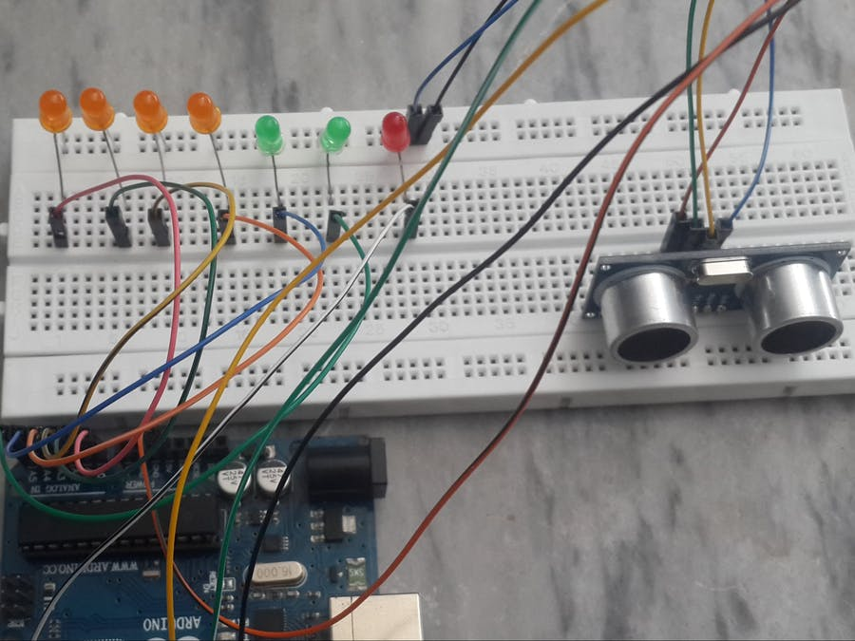
Distance Monitor

Slide 27
IR Sensor

Slide 28
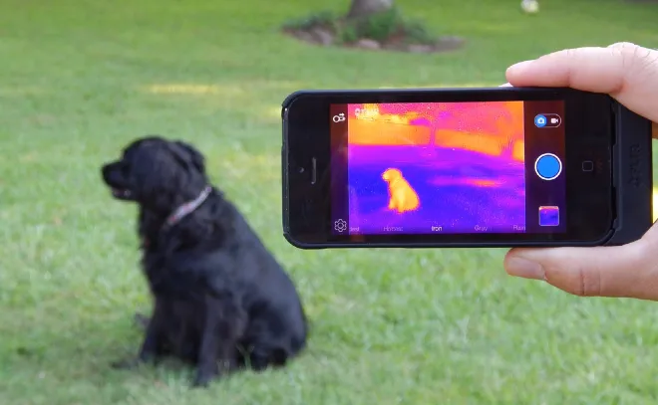
What is IR?
Infrared, sometimes called infrared light, is electromagnetic radiation with wavelengths longer than those of visible light. It is therefore invisible to the human eye.

Slide 29
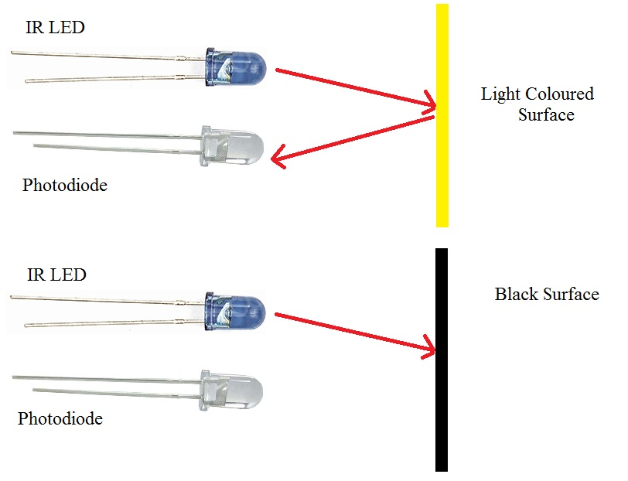
IR Sensor

Slide 30
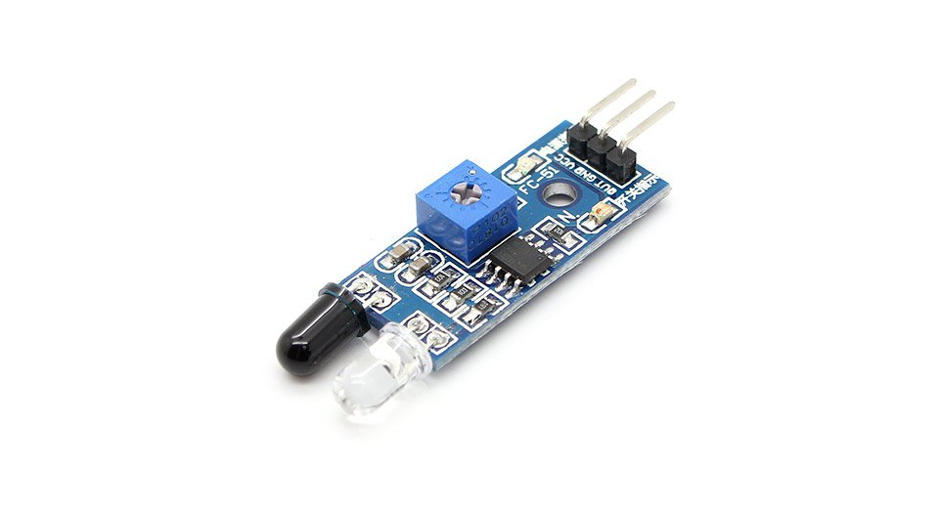
IR Sensor

Slide 31
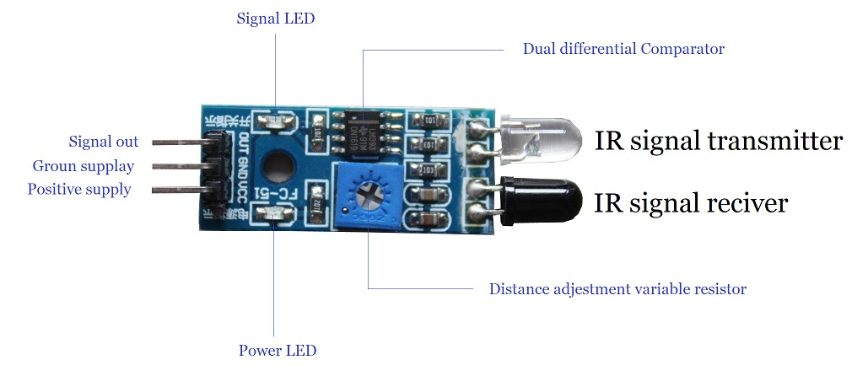
IR Sensor

Slide 32
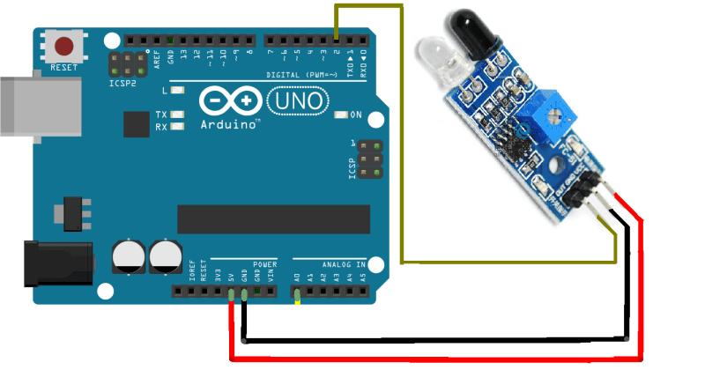
IR Sensor

Slide 33
Thank you

